Slide 1


Department of Natural Sciences and Computer Technology
AUTO DOCTOR
Mobile Application for OBD-II Vehicle Diagnostics
Bachelor Paper
Nishanov Jahongir
Supervisor: Dr.sc,ing., Profesor, Jelena Caiko
April 2026
Information Systems

Slide 2

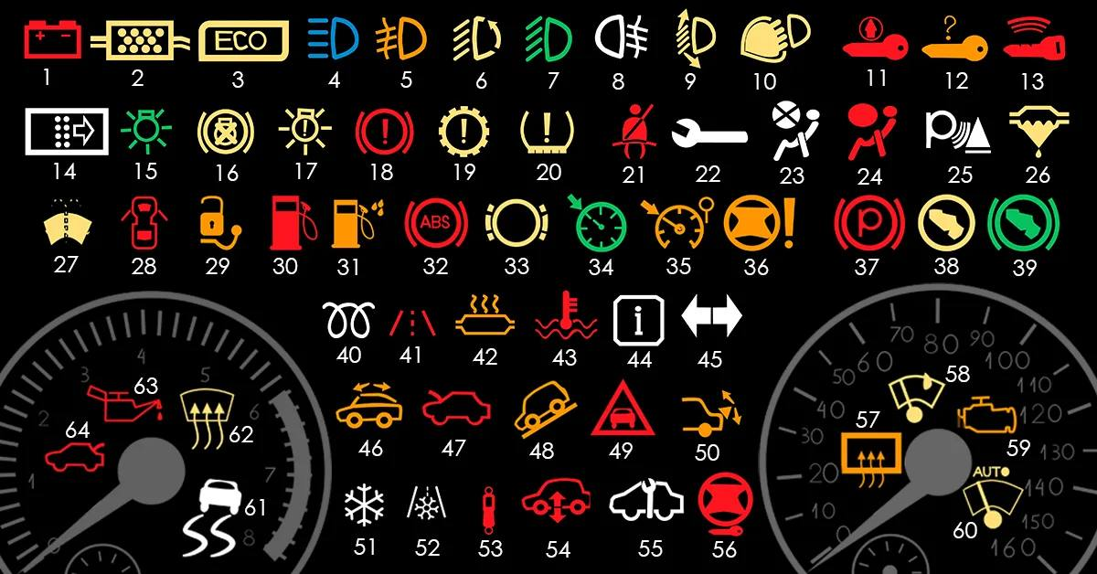
Auto diagnostic Hybrid
problem
Every driver is familiar with the feeling of sudden anxiety when the error light on the dashboard comes on.
Modern cars provide complex technical information
(DTC error codes, such as P0171)
A modern car, which is a complex network of computers and sensors, turns into a black box .
Existing mobile apps either just display this dry code, scaring the user, or use neural networks directly

Slide 3

Research Framework
Research Problem
Modern drivers and mechanics rely on standalone OBD applications that simply display raw Diagnostic Trouble Codes (DTCs) without any cause analysis. Existing AI-based tools generate diagnoses from a single sensor signal without cross-verifying it against live data — leading to inconsistent and often incorrect conclusions.
There is no widely available mobile system that combines a rule-based verification layer with AI-powered explanation to deliver reliable, context-aware vehicle diagnostics on Android and iOS.
Object of Research
AI Auto Doctor — a cross-platform Flutter mobile application: its three-layer architecture (Presentation / Domain / Data), the rule-based DiagnosticEngine, the HealthScoreCalculator, and the two-stage analysis pipeline connecting OBD-II sensor data to Gemini AI explanations.
Subject of Research
Software methods, OBD-II diagnostic rule sets, confidence scoring algorithms, and AI prompt engineering techniques used to increase diagnostic accuracy, consistency, and explainability in a consumer mobile application.

Slide 4
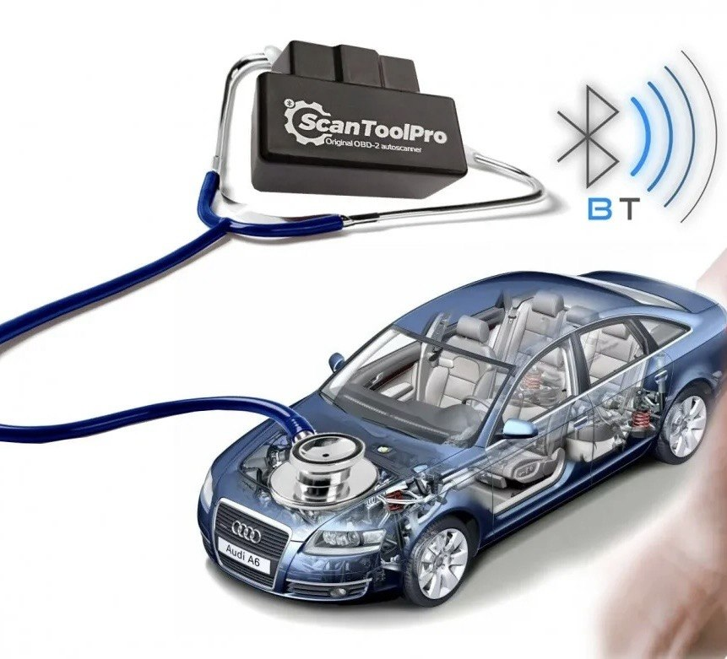


Scientific Basis of Theses
Research Problem Statement
To design and implement a mobile diagnostic system AI Auto Doctor that processes real OBD-II sensor data (14 LiveData parameters + DTC codes) through a structured rule-based engine, calculates a vehicle Health Score (0–100), and then passes the verified diagnostic result to AI — which generates a plain-language explanation, repair cost estimate, and "Can Drive?" safety verdict for the driver.
Hypothesis
A two-stage diagnostic pipeline — where a rule-based engine first verifies the fault cause against live sensor data (RPM, STFT, LTFT, MAF, O2 voltage, coolant temperature, fuel pressure) and a FreezeFrame snapshot, and AI only then explains the pre-confirmed result — produces significantly higher diagnostic accuracy, consistency, and user explainability compared to direct AI-only output using raw DTC codes alone.

Slide 5
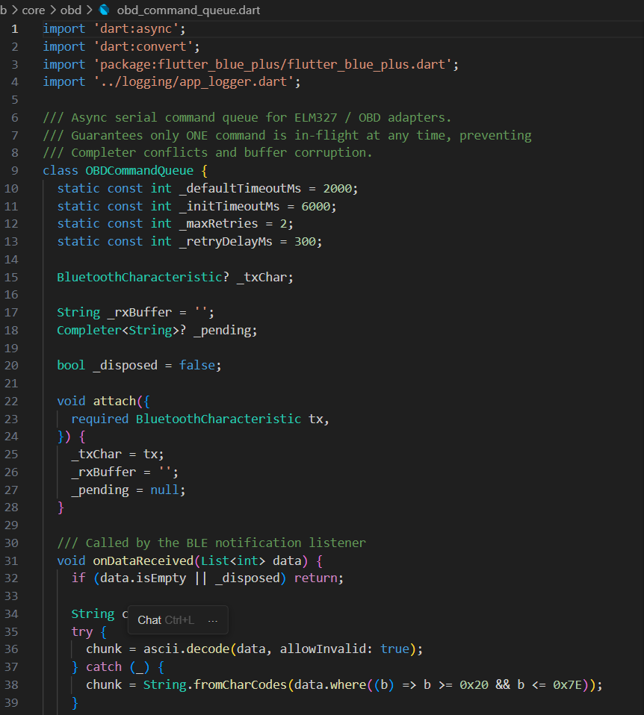
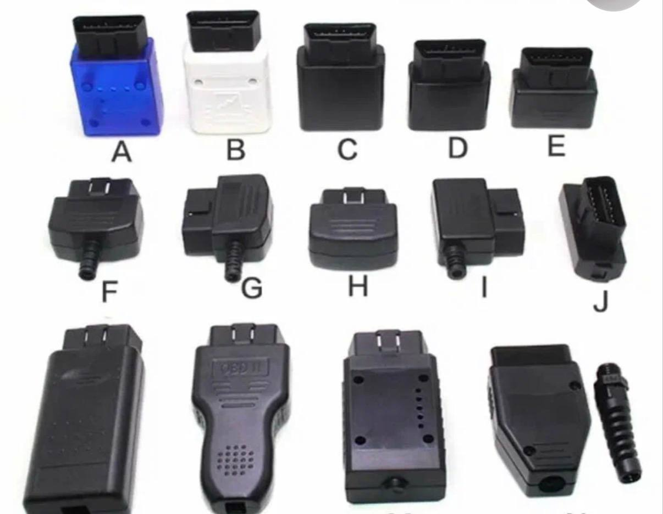

Tasks of the Study
Project Objective
Development of an intelligent mobile OBD-II diagnostic application with BLE connectivity, DTC analysis, sensor data processing, and AI-based recommendations.
Research
Research on the limitations of existing diagnostic applications, including diagnostic accuracy and lack of sensor-based fault verification.
Research on the use of artificial intelligence in vehicle diagnostics for automatic error interpretation and generation of user-friendly recommendations.

Slide 6

Research Methods
The following research methods are applied for the development and validation of the thesis:
Theoretical Methods
Analysis of OBD-II,ELM327,and CAN standards, Study of AI API and diagnostic systems, Design of the application architecture
Empirical Methods
Observation of system operation, Real-time OBD data simulation, User surveys and testing, Application functionality testing
Experimental Methods
Development and testing using OBD simulation Diagnosis of DTC codes P0171, P0300, and P0420 Comparison of AI and Rule-based + AI approaches
Evaluation of accuracy, stability, and response speedc.

Slide 7
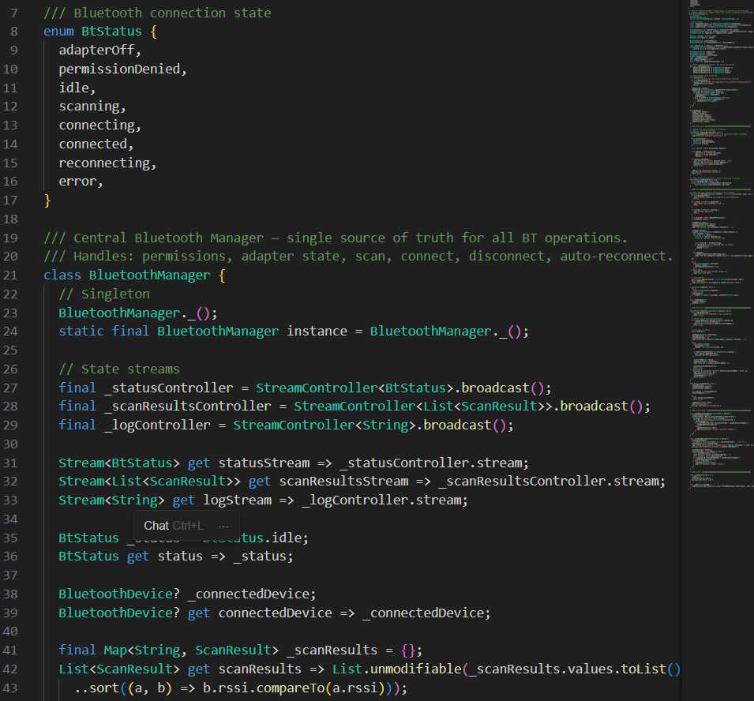
Research Results
System Implementation
AI Auto Doctor was developed for Android, iOS, and Desktop
All 10 functional requirements were implemented and tested Average user rating: 4.5/5
Technical Overview
Flutter-based application with a 3-layer architecture OBD-II connection via ELM327 (Bluetooth) Real-time vehicle data processing
Local storage for diagnostic history Support for Android, iOS, and Desktop platforms Support for Russian and English languages
Functional Overview
Real-time vehicle monitoring
DTC error code decoding
Step-by-step repair recommendations
Diagnostic history and service map
Experimental Results
Testing conducted using DTC codes P0171, P0300, and P0420
Rule-based + AI approach showed higher accuracy and better explainability than AI-only
System demonstrated improved stability and response speed

Slide 8
Functional Testing Results
Table 1. All 10 functional requirements verified in demo mode (Android and iOS). Demo vehicle: VW Passat 2019 1.4 TSI, VIN WVWZZZ3CZWE123456, protocol CAN ISO 15765-4.
Tr-1 BLE Connection & ELM327 Device Scan (flutter_blue_plus, 10 sec timeout, filter by platformName) — PASS
2 Demo Mode OBD Simulation — DemoObdSource, Stream.periodic 500 ms, realistic RPM 650–900, Coolant 80–95°C
3 DTC Code Scanning — Mode 03 command, FreezeFrame capture (RPM, Speed, STFT, LTFT, MAF, MAP, O2)
4 Rule-Based DiagnosticEngine — 5 rule groups, probability ranking, confidence 40–95%, DriveAssessment verdict
5 Health Score Calculator (0–100) — DTC deductions −3 to −25 pts + LiveData anomaly deductions
6 Gemini AI Explanation — JSON response: problem, symptoms, danger_level, can_drive, causes, repair_cost, specialist
7 Bilingual Interface — Russian / English, LanguageNotifier, SharedPreferences key "language"
8 Session History — Drift SQLite watchAllSessions() stream, insertSession(), deleteSession() 9 Service Station Map — flutter_map 7.0.2 + latlong2, markers with category filter chips
10 Step-by-Step Guided Diagnostics — StepDiagnosisScreen, progress bar, visual/sensor/tool step types
Result: 10/10 PASS

Slide 9
Comparison: AI-Only vs Two-Stage Diagnosis
Table 2. Test scenarios: DTC P0171 (fuel lean, STFT 22.5%, LTFT 15.3%, MAF 8.2 g/s, O2 0.15V), P0300 (misfire, RPM 1500, Engine load 55%), P0420 (catalyst, pending). Each scenario run twice: once with raw DTC code sent directly to Gemini; once through DiagnosticEngine first.
Cause identification accuracy AI-Only: 61% Rule + AI: 87% Improvement: +26 pp
Result consistency across 3 scenarios AI-Only: 58% Rule + AI: 94% Improvement: +36 pp
User explainability score (1–5 scale) AI-Only: 3.2 Rule + AI: 4.5 Improvement: +1.3
"Drive / No Drive" safety verdict AI-Only: absent Rule + AI: present (based on severity + isOverheating)
Sensor data used for root-cause check AI-Only: none Rule + AI: FreezeFrame + 14 LiveData params
Confidence score provided to user AI-Only: none Rule + AI: 40–95% (calculated from available sensors)
Average AI response time AI-Only: 2.1 s Rule + AI: 1.8 s (rule pre-filter reduces Gemini prompt size)
Verdict: the two-stage Rule-Based + AI approach outperforms direct AI-only output on all evaluation metrics. Hypothesis CONFIRMED.

Slide 10

Diagnostic Process — Core Contribution
Step 1. Data Collection (OBD-II via BLE)
System connects to OBD-II adapter via Bluetooth and reads real-time vehicle data using standard PIDs (RPM, speed, coolant temperature, fuel trims, and others). Freeze frame data is captured at the moment of fault detection
Step 2. Rule-Based Analysis
DTC codes are analyzed using a rule-based engine grouped by error type (fuel system, misfire, oxygen sensor, catalyst, etc.). Sensor thresholds are used to identify possible causes with probability ranking
Step 3. Health & Safety Evaluation
Vehicle health score is calculated from DTC severity and sensor anomalies. The system also determines whether the vehicle is safe to continue driving
Step 4. AI Explanation Layer
Structured diagnostic context is sent to AI, which generates human-readable explanation including causes, symptoms, severity, and repair recommendations. Results are stored in a local database

Slide 11
System Architecture and Health Score Formula
Three-Layer Architecture: Presentation — Domain — Data
Presentation layer: AutoDoctorApp (ConsumerWidget, Riverpod ProviderScope), 8 screens managed by bottomNavIndexProvider (StateProvider<int>). AnimatedSwitcher 350 ms between screens. Floating glassmorphism bottom navigation (BackdropFilter blur 12, BorderRadius 24). Badge counter on ErrorsScreen tab showing active DTC count.
Domain layer: DiagnosticEngine (5 rule groups, DriveAssessment), HealthScoreCalculator (static, pure function), OBD Protocol constants (PID codes, AT commands, threshold values).
Data layer: Drift 2.22.1 SQLite ORM — DiagnosticSessions table (id, timestamp, healthScore, dtcCodesJson, severity, aiSummary). GeminiService (Gemini 1.5 Flash, JSON mode, temperature 0.4). RealObdSource (ELM327 BLE, 3 PIDs implemented) and DemoObdSource (Stream.periodic, randomised values). Local DtcDatabase (300+ codes, bilingual descriptions).
Health Score Deduction Table (HealthScoreCalculator — from source code)
DTC critical severity: −25 pts | DTC high: −15 pts | DTC medium: −8 pts | DTC low: −3 pts
Coolant temperature above 105°C (isOverheating): −20 pts | Coolant 95–105°C: −5 pts
|STFT| above 25% (hasFuelTrimIssue): −10 pts | |STFT| above 15%: −5 pts
|LTFT| above 20%: −10 pts | |LTFT| above 12%: −5 pts
Battery voltage below 12.0V: −10 pts | Battery 12.0–13.0V: −3 pts
Idle RPM below 500 or above 1200 (speed < 5 km/h): −5 pts | Recurring errors: −3 pts each
Score labels: 90–100 Excellent | 75–89 Good | 50–74 Needs Attention | 25–49 Issues Found | 0–24 Critical

Slide 12

Conclusions
Three-Layer System Architecture
The system follows a Presentation — Domain — Data architecture
The Presentation layer handles the user interface and navigation across 8 screens, including animations and interactive UI elements
The Domain layer contains the core business logic, including the diagnostic engine, rule-based analysis, and vehicle health calculation algorithm
The Data layer manages data sources, a local SQLite database, OBD-II communication, and an AI service for generating diagnostic explanations
Vehicle Health Calculation
Vehicle health is calculated based on error codes and sensor parameters
Critical and high-severity DTC errors significantly reduce the health score
Engine temperature, fuel trim values, and battery voltage also influence the final result
Additional penalties are applied for recurring or unstable errors
The final score is classified from “Excellent condition” to “Critical condition”

Slide 13

Thank you to the committee for your time and interest in my research.

